Slide 1
Mail Services
By Amit Patel
<number>1

Slide 2
E-mail
Full Form: Electronic Mail.
Definition: E-mail is a method of exchanging digital messages over a network from one user to anothers.
E-mail is text-based mail consisting of lines of text and include attachments such as audio messages, pictures and documets.
Modern email operates across the internet and other computer networks.

Slide 3
Features of E-mail
Sent to one person or more than one person at the same time.
Communication via e-mail does not require physical presence of the recipient.
Fast way to communication with people as compared to postal office.
Sent at any time of the day.
A copy of e-mail message that the sender has sent is available on the sender’s computer for later reference.
The recipient of e-mail can read the mail, forward it or reply back. The recipient can also store the email or delete it.

Slide 4
E-mail Address
To use e-mail, a user must have an e-mail address.
E-mail address contains all information required to send or receive a message from anywhere in the world.
An e-mail address consists of two parts separated by two parts separated by @ symbol.
The first part is user_name and second part is host computer name.

Slide 5
E-mail Address
The e-mail address may looks like
    patelamitrp@yahoo.com
Where:
  patelamitrp is user name
  Yahoo.com is host computer name or domain name, is the mail box where finally the mail will be delivered.

Slide 6
E-mail Message Format
The e-mail message consists of two parts.
    Header
    Body
The header contain information about the message such as:
  From: Sender’s E-mail address.
  To: Recipient’s E-mail address.
  Date: When E-mail was sent.
  Subject: The topic of the message.

Slide 7
E-mail Message Format
  Cc: Address where carbon copy of the same message with be sent. The recipients of e-mail can see all e-mail addresses to which the copies have been sent.
  Bcc: Address where Blind Carbon Copies of the same e-mail sent. The receipient of e-mail don’t know that the same e-mail has been sent to other e-mail addresses.
  The size of the e-mail.
  Body contain the text of the messages and any attachment to be sent.

Slide 8
E-mail Services
There are two kinds of E-mail services
  Application Based
  Web Based
Application Based:
  It is installed onto the user’s computer.
  The mail is stored on the user’s computer.
  For using the application based e-mail, the user use a program like Microsoft Outlook.

Slide 9
E-mail Services
Web Based:
  Web based or Webmail appear in web browser’s window.
  It can be accessed by user from any internet connected computer anywhere in the world.
  It is not stored in user’s computer.
  Hotmail, yahoo and gmail provide free e-mail accounts.
  For example: patelamitrp@yahoo.com is webmail address.

Slide 10
E-mail Protocol
E-mail uses the services of following protocols.
  SMTP ( Simple Mail Transfer Protocol ) : Used to send e-mail from the client to server and from server to another server.
  POP3 ( Post Office Protocol ) : Used by client for application based e-mail to access mail from the server.
  IMAP ( Internet Message Access Protocol ): Used by client for web based e-mail to access mail on server.

Slide 11
SMTP
Full Form: Simple Mail Transfer Protocol.
It is a standard protocol used for sending e-mail efficiently and reliably over the internet.
SMTP is application level protocol.
SMTP is connection oriented protocol.
SMTP is text based protocol.
It handles exchange of messages between e-mail servers over TCP/IP network.
Apart from transferring e-mail, SMPT also provides notification regarding incoming mail.

Slide 12
SMTP
When you send e-mail, your e-mail client sends it to your e-mail server which further contacts the recipient mail server using SMTP client.
These SMTP commands specify the sender’s and receiver’s e-mail address, along with the message to be send.
The exchange of commands between servers is carried out without intervention of any user.
In case, message cannot be delivered, an error report is sent to the sender which makes SMTP a reliable protocol.

Slide 13
MIME
Full Name: Multipurpose Internet Mail Extensions.
It is an extension of the original Internet e-mail protocol that lets people use to exchange different kinds of data files on the Internet: audio, video, images, application programs.
It support:
  Text in character set other than ASCII.
  Non-text attachments.
  Message bodies with multiple parts.

Slide 14
POP3
Full Form: Post Office Protocol.
It is generally used to support a single client. There are several versions of POP but the POP 3 is the current standard.
POP is an application layer internet standard protocol.
Since POP supports offline access to the messages, thus requires less internet usage time.
POP does not allow search facility.
In order to access the messaged, it is necessary to download them.
It allows only one mailbox to be created on server.

Slide 15
IMAP
Full Form: Internet Mail Access Protocol.
It was first proposed in 1986.
There exist five versions of IMAP as follows:
  Original IMAP
  IMAP2
  IMAP3
  IMAP2bis
  IMAP4

Slide 16
IMAP
IMAP allows the client program to manipulate the e-mail message on the server without downloading them on the local computer.
The e-mail is hold and maintained by the remote server.
It enables us to take any action such as downloading, delete the mail without reading the mail.
It enables us to create, manipulate and delete remote message folders called mail boxes.
IMAP enables the users to search the e-mails.
It allows concurrent access to multiple mailboxes on multiple mail servers

Slide 17
How E-mail Work?
E-mail works on client-server model.
The client connect to e-mail server when the user want to send, check or receive e-mail.
  The client connect to the server on two TCP/IP Port.
  SMTP on port 25
  POP3 on port 110 or IMAP on Port 143.
SMTP server accepts outgoing e-mail form the client.
SMTP Server check the e-mail address at which e-mail has to be delieverd.

Slide 18
How Email Works?
  If the recipient e-mail client resides on the same SMTP server , then the e-mail is sent to the local POP or IMAP Server.
  Otherwise, e-mail is sent to another SMTP server so that the it reach the recipient e-mail client’s SMTP Server.
POP3 stores e-mail for a client on a remote server. When the client gets connected to server, the e-mail message are downloaded from POP3 server to client’s computer.

Slide 19
How E-mail Works?
IMAP also store e-mail on remote server. However, e-mail message are not downloaded to the client’s computer. The user directly manipulate e-mail on the e-mail server.

Slide 20
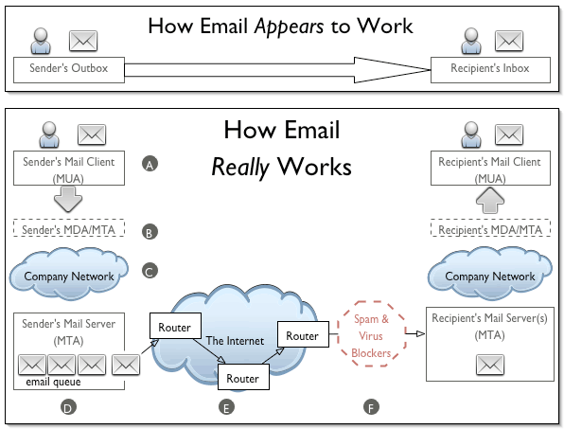

Slide 21
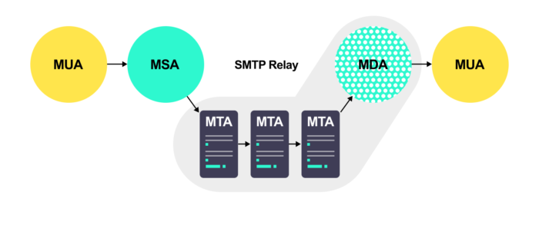

Slide 22
Component of Email Service
Email Client or Mail User Agent (UA / MUA)
An email client or a user agent is a software application or a program that is used to compose and read the email.
On the sender side, it is used to compose and send the email.
On the receiver side, it is used to read and reply to the received email.
MS Outlook, macOS Mail, /bin/mail, Alpine, and Gmail are some examples of email client programs.

Slide 23
Component of Email Service
Mail Transfer Agent (MTA / Mail Relay)
Sends and communicates email messages from one base station on a channel to the next.
It utilizes a protocol named as the SMTP (Simple Mail Transfer Protocol) protocol to conduct its tasks.
It receives an email from the mail user agent (MUA).
Once the MTA gets the email, relaying comes into play.

Slide 24
Component of Email Service
MTAs do the following:
accept emails sent from mail user agents
query the MX records and select a mail server to transfer emails
send auto-response messages if an email has failed to reach the destination

Slide 25
EMAIL
Essential MTA operations are listed below.
Outgoing mail operation
Receive outgoing emails from UA and MSA
Understand the recipient’s addresses
If require, rewrite the addresses
Perform a DNS MX lookup to resolve the recipient’s address
If the recipient is directly accessible, forward the email to MDA
If the recipient is not directly accessible, forward the email to the next responsible MTA

Slide 26
EMAIL
Incoming mail operation
Receive incoming mails from other MTA
Understand the recipient’s addresses
If the recipient belongs to it, perform a virus scan and forward the email to MDA
If the recipient does not belong to it, forward the email to the next responsible MTA

Slide 27
Component of Email Service
Mail Submission Agent (MSA)
MSA takes emails from the user agent and delivers them to a mail transfer agent.
If implemented, MSA sits between a user agent and a mail transfer agent (MTA).
It secures the connection between UA and MTA by implementing encryption and authentication.
Besides this, it can perform many more tasks based on its configuration, such as rewriting the email header and performing security checks.

Slide 28
Component of Email Service
Mail Delivery Agent (MDA)
MDA takes emails from MTA and delivers them to the message store.
Take services of POP3 and IMAP protocol
Since MDA delivers emails to the local system, it is also known as LDA (local delivery agent).
Same as MSA, several additional functionalities such as virus scanning and spam email filtering can be configured on MDA.
MSA and MDA are part of MTA.

Slide 29
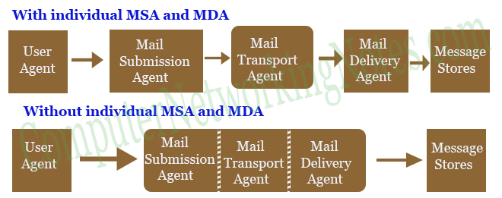

Slide 30
EMAIL
POP3
POP3 is a one-way protocol.
It can only download messages in email clients from the message store.
It keeps locally stored messages intact or simply deletes them once they are downloaded.

Slide 31
EMAIL
IMAP
IMAP is a two-way protocol.
Besides downloading messages from the message store, it also updates the message store about the action which user performs on the downloaded messages.
Since the message store knows the action which user takes on the downloaded messages, it automatically performs that action on locally stored messages to keep a similar copy of messages at both locations.

Slide 32
EMAIL
This protocol uses advanced techniques to download messages in email clients from the message store. It only downloads the header of mail. It downloads contents and attachments of mail only when the user reads the mail.

Slide 33
Step By Step Process of EMAIL
First the sender needs to enter the email address of the recipient along with the message using an email application.
This should be done at the local computers. Once it is finished and the “Send” button is clicked, the email will be going to the MTA (The Mail Transfer Agent).
This communication is done via the SMTP protocol.

Slide 34
EMAIL
The next step is DNS lookup.
The system sends a request to find out the corresponding MTA of the recipient.
This will be done with the help of the MX record.
In the DNS zone, for the receiver address’ domain, there will be an MX record (stands for Mail Exchanger record). This is a DNS resource record which specifies the mail server of a domain.
So, after the DNS lookup, a response is given to the requested mail server with the IP address of the recipient’s mail server. This way the ‘to’ mail server is identified.

Slide 35
EMAIL
The next step is transferring the message between the mail servers.
The SMTP protocol is used for this communication.
Now our message is with the recipient mail server (MTA).

Slide 36
EMAIL
Now, this message is transferred to the Mail Delivery Agent and then it is transferred to the recipient’s local computer.
Two protocols can be used here.
If we use POP3, then the whole email will be downloaded to the local computer and the copy at the server gets deleted.
If the protocol used is IMAP, then the email message is stored in the mail server itself, but the user can easily manipulate the emails on the mail server as in the local computer.
This is the difference when using both the protocols and this is how your email gets delivered.

Slide 37
POP | IMAP
Generally used to support single client. | Designed to handle multiple clients.
Messages are accessed offline. | Messages are accessed online although it also supports offline mode.
POP does not allow search facility. | It offers ability to search emails.
All the messages have to be downloaded. | It allows selective transfer of messages to the client.
Only one mailbox can be created on the server. | Multiple mailboxes can be created on the server.

Slide 38
POP | IMAP
Not suitable for accessing non-mail data. | Suitable for accessing non-mail data i.e. attachment.
POP commands are generally abbreviated into codes of three or four letters. Eg. STAT. | IMAP commands are not abbreviated, they are full. Eg. STATUS.
It requires minimum use of server resources. | Clients are totally dependent on server.
Mails once downloaded cannot be accessed from some other location. | Allows mails to be accessed from multiple locations.
The e-mails are not downloaded automatically. | Users can view the headings and sender of e-mails and then decide to download.
POP requires less internet usage time. | IMAP requires more internet usage time.

Slide 39
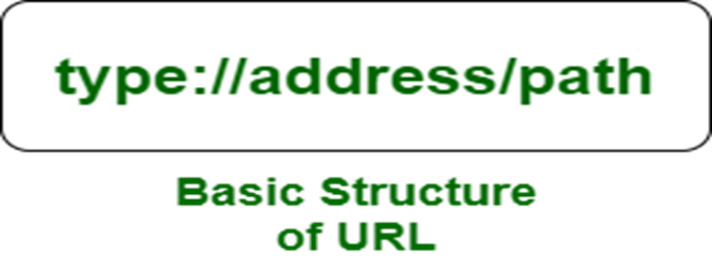
URL
Uniform Resource Locator.
Address of a resource on the World Wide Web and the protocol used to access it.
These resources can be a CSS document, an HTML page, an image, a video, and many more.
URLs make it possible for a document or webpage to be accessible anywhere in the world and on any type of device.
For example, to visit the google website, you will go to the URL www.google.com, which is the URL for the google website.

Slide 40
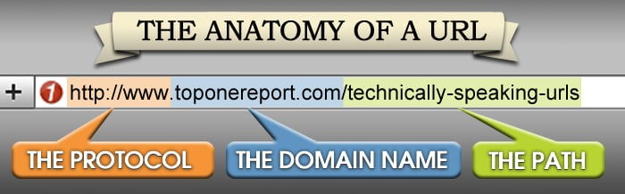

Slide 41
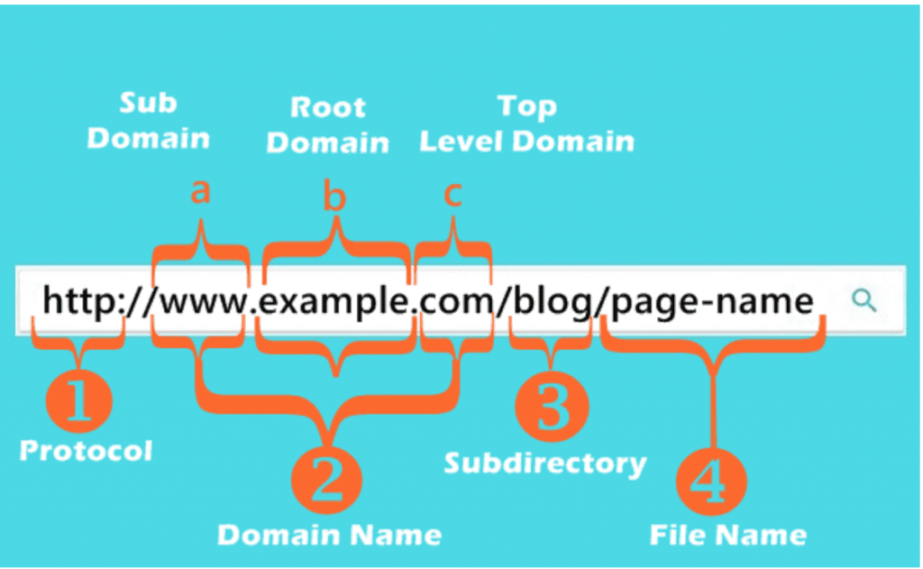

Slide 42
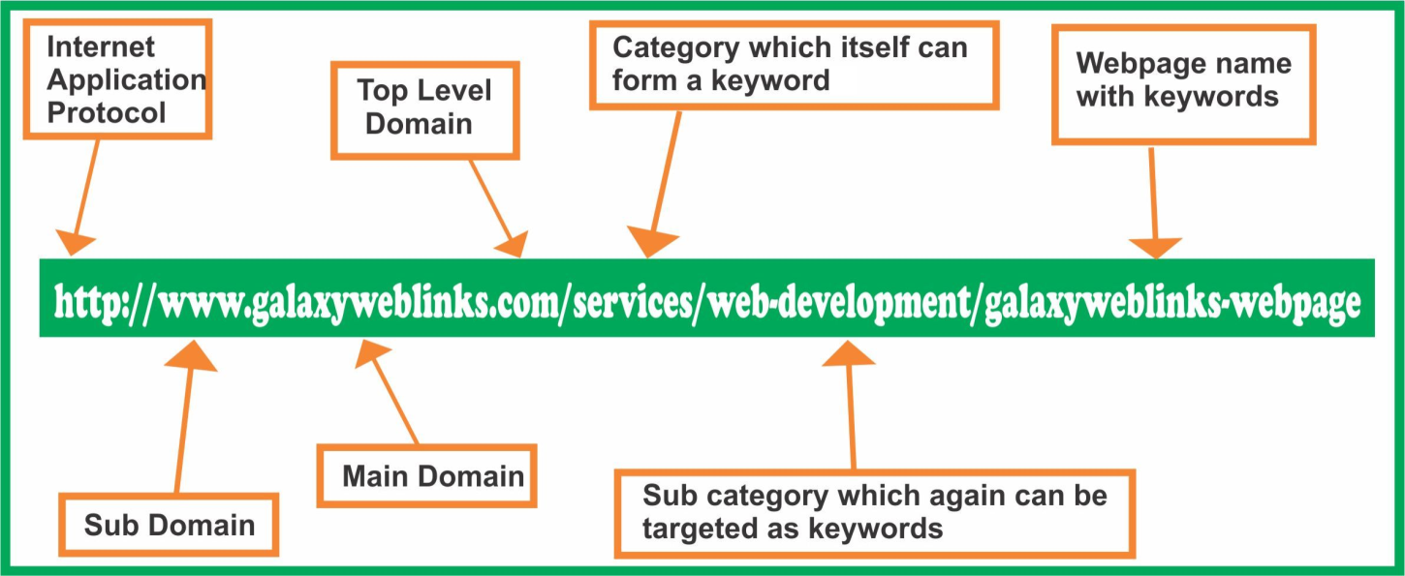

Slide 43
URL
When you search any query on Google, it will display the multiple URLs of the resource that are all related to your search query.
The displayed URLs are the hyperlink to access the webpages.
URLs are a mix of Case Insensitive and Case Sensitive parts.
A URL (Uniform Resource Locator) contains the information, which is as follows:

Slide 44
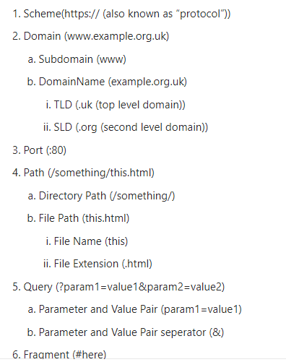

Slide 45
URL Parts
Scheme (Protocol)
Authority(Subdomain, Root domain, Top Level Domain)
Port
Path (File / Page Request)
Parameter
Anchor

Slide 46
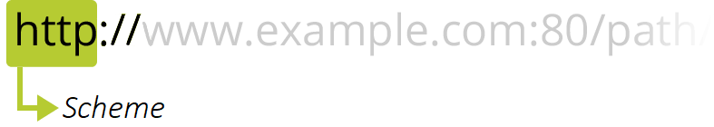
URL Parts : Scheme
Indicates the protocol that the browser must use to request the resource (a protocol is a set method for exchanging or transferring data around a computer network). Usually for websites the protocol is HTTPS or HTTP (its unsecured version)

Slide 47
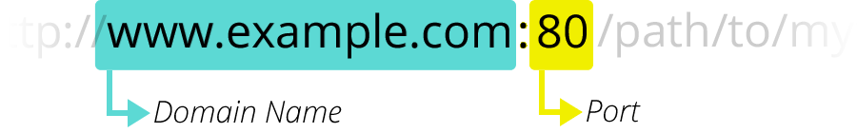
URL Parts : Authority
The separator between the scheme and authority is ://.
The colon separates the scheme from the next part of the URL, while // indicates that the next part of the URL is the authority.
If present the authority includes both the domain (e.g. www.example.com) and the port (80), separated by a colon:
The domain indicates which Web server is being requested.
The port indicates the technical "gate" used to access the resources on the web server.(80 for HTTP and 443 for HTTPS)

Slide 48
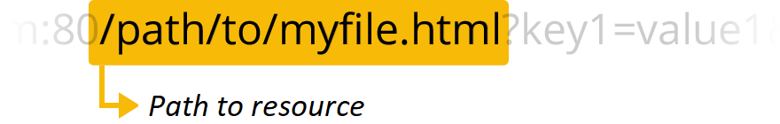
URL Parts : Path
path/to/myfile.html is the path to the resource on the Web server.
In the early days of the Web, a path like this represented a physical file location on the Web server.

Slide 49
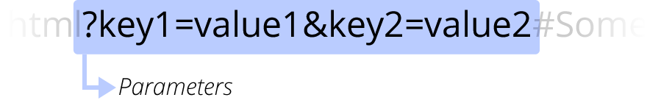
URL Parts : Parameters
?key1=value1&key2=value2 are extra parameters provided to the Web server.
Those parameters are a list of key/value pairs separated with the & symbol. The Web server can use those parameters to do extra stuff before returning the resource. Each Web server has its own rules regarding parameters

Slide 50
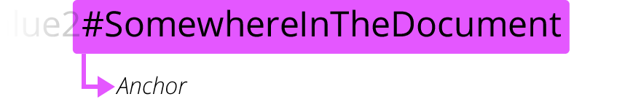
URL Parts : Anchors
#SomewhereInTheDocument is an anchor to another part of the resource itself.
An anchor represents a sort of "bookmark" inside the resource, giving the browser the directions to show the content located at that "bookmarked" spot.

Slide 51
Why We Require URL?
Provides users the option to switch from one web page to another by clicking only one mouse click.
Tells users how to access a specific resource.
When a user types a URL into the web browser and opens any hyperlink from search results, the browser forwards a request to a webserver to fetch files related to the search query.
URL identifies one particular file, and it is the most important part of your website.

Slide 52
Absolute URL
An absolute URL is a complete page address.
It includes the protocol, the domain, and the folder system located within your website.
It shows all of the information and steps you need to go through to reach the page in the search engine.
Example:
https://www.aburl.com/zyx.html

Slide 53
Relative URL
Does not contain the full page address, and rather only has the location following after the domain.
A Relative URL is targeted to a file or directory in relation to the present file or directory.
By assumption, the relative URL understands that the link you enter is part of the same site/root domain that you are already on.
Example:
zyx.html
category/file.htm

Slide 54
Relative URL
If the website has several sections and the files and web pages for each section have been segregated into different directories.
This helps in keeping things organized and uncluttered on the website. The relative URLs and hence the file size of the web page would reduce if you use the former.

Slide 55
Web Browser
Definition: Web Browser is software application for retrieving, presenting and traversing information resources on the World Wide Web.
Purpose: To bring information resources to the user, allowing them to view the information ("display", "rendering"), and then access other information ("navigation", "following links").
It connects the user to any website and provides the facility of viewing, listening reading and collecting the information available on the websites.

Slide 56
Web Browser
Web browser sends requests to the server computer regarding the desired website.
Number of browser are available but the most popular browsers are :
  Internet explorer (IE)
  Google Chrome
  Firefox
  Safari

Slide 57
Search Engine
Definition: A search engine is a software program that searches for sites based on the words that you designate as search terms.
Search engines look through their own databases of information in order to find what it is that you are looking for.
Alan Emtage is a father of search engine.
Very first tool used for searching on the Internet was Archie. It was created in 1990.

Slide 58
Search Engine | Started
google | 1998
yahoo | 2004
Bing | 2009
MSN | 1998
Duckduckgo | 2008
Volunia | 2012

Slide 59
How Search Engine Work?
A search engine operates in the following order:
  Web crawling
  Indexing
  Searching and Generate SERP

Slide 60
How Search Engine Work?
Web Crawling:
Web search engines work by storing information about many web pages, which they retrieve from the HTML markup of the pages. These pages are retrieved by a Web crawler.
It is a software program.
It follows every webpage and link on the site.
Take all the site information and store into the database.
It store how many time searching word appear in site.
Also known as a “spider” and “Robot”.

Slide 61
How Search Engine Work?
Indexing
The search engine then analyses the contents of each page to determine how it should be indexed for example, words can be extracted from the titles, page content, headings, or special fields called meta tags.
Data about web pages are stored in an index database for use in later queries.
A query from a user can be a single word. The index helps find information relating to the query as quickly as possible.

Slide 62
How Search Engine Works?
Searching and Generate SERP
When a user enters a query into a search engine (typically by using keywords), the engine examines its index and provides a listing of best-matching web pages according to its criteria, usually with a short summary containing the document's title and sometimes parts of the text.
Then generate result or list of website on Search Engine Result Page.(SERP)

Slide 63
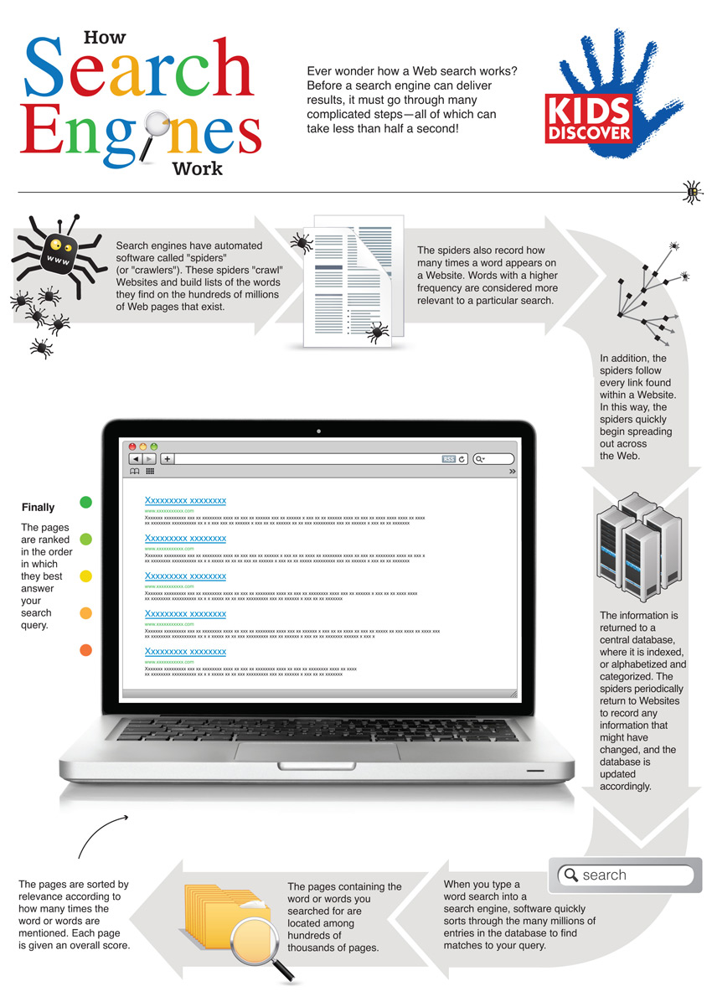

Slide 64
Meta Search Engine
Known As : Multi Threaded Engine
Definition: A Search Engine that queries other search engines and then combines the results that are received from all.
Meta-search engines do not crawl the Web or maintain a database of web pages.
Instead, they act as a middle agent, passing on the query to the major engines and then returning the results.
In effect, the user is not using just one search engine but a combination of many search engines at once to optimize Web searching.

Slide 65
List Of Meta Search Engine
Meta Search Engine
Dogpile
Yippi
Excite
Blingo
DeeperWeb

Slide 66
How Meta Search Engine Works?
Meta search engines create what is known as a virtual database.
They do not compile a physical database or catalogue of the web.
Instead, they take a user's request, pass it to several other heterogeneous databases and then compile the results in a homogeneous manner based on a specific algorithm.

Slide 67
Difference
META SEARCH ENGINE | SEARCH ENGINE
A meta-search engine is a search tool that sends user requests to several other search engines and/or databases and aggregates the results into a single list or displays them according to their source. | A search engine is a search tool that usually have their own database of sites they crawl and list in their database
Meta Search Engines usually do not have their own database of crawled sites, they search the databases of real search engines. | Search engine usually have their own database of sites.
For Example: dogpile, excite | For example: Google, bing

Slide 68
Telnet
TELNET means TELecommunication NETwork
Telnet is a simple, text-based program that allows you to connect to remote computer on the Internet using a username and password.
Provides capability to log onto a remote computer. Hense it is also known as remote login.
To use Telnet to access a device you have to actually have access permission.
This features allows PC’s to communicate successfully with remote pc, help user to tap into internet computers and access public files.
Telnet uses TCP port 23

Slide 69
Continue…..
Telnet session is established by using telnet client software.
The user request session to be established with remote host by providing its host name of IP Address.
The telnet client software locates the host over the internet and establish a remote login session to that host.
The only potensial down side is you must know the computer you are logged onto and the remote computer must also grant you access.
When you connect, your computer acts as if your keyboard is attached to the remote computer.

Slide 70
TelNet
When you type any command, it is executed on the remote computer.
You can observer on your monitor what is taking place on the remote computer when telnet session is going on.
The computer on which you are working by sitting in front of it is called local computer. The telnet connection is to be initialized from this machine.
The machine being connected to, which grant the connection is referred to as the remote computer. It is also known as telnet server.

Slide 71
Characteristics
Bidirectional: That means Telnet is not one-way; it can be used to send and receive information.
Interactive: That means Telnet basically expects a live user on one end of the line. Telnet is not usually used for computers to talk autonomously with each other, but was built from the ground up to be human-readable.
Text-oriented: Telnet is a text-only protocol; you won’t see graphics or fancy images while working with Telnet, nor will you be able to transfer files with Telnet.

